Slide 1
From Requirements to Code with AI
Requirements → Code

Slide 2
John Michael Miller
Senior Software Engineer at Code Staffing
Played roles of developer, architect, devops engineer, platform engineer, test architect, release manager
AI/ML Enthusiast and advocate for Effectively using AI to write code
LinkedIn: www.linkedin.com/in/johnmichaelmiller
Email: john.miller@codestaffing.com
Blog: https://codemag.com/blog/AIPractitioner
Resources: https://ai-resources.codemag.com

Slide 3
Agenda
Prompt-first
AI Assisted Workflow
Project Requirements
What requirements?
Conceptual Models
Workflows
Use Cases
Chat modes
Product Manager, SME
Software Architect
Instructions
Create Use Case
Instruction Standards
Prompt Standards
Project Instructions
Prompts
Create Use Cases from Workflows
Create Product Manager chat mode
Create Software Architect chat mode
Create Project Instructions

Slide 4
Prompt-First Development
A development methodology that prioritizes crafting effective prompts and leveraging Large Language Models (LLMs) to generate code and solutions.
Prompt Engineering: Core skill for developers
LLM Integration: Heavy reliance on AI assistants for code generation
Iterative Refinement: Continuous prompt optimization
Natural Language: Requirements often expressed conversationally

Slide 5
The Webinar Repository
Search GitHub for
CODE-Presents-From-Requirements-to-Code-with-AI
Fork the repo
This will create a personal copy under your GitHub account
You can push commits without affecting the original repo

Slide 6
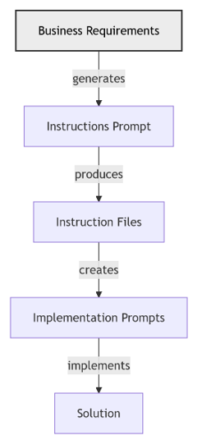
From Requirements to a Solution
Stakeholders define the requirements
AI generates prompts that transform the requirements into implementation instruction files
Stakeholders review, improve, and approve prompts that generate instruction files
AI produces implementation instruction files
Stakeholders review, improve, and approve implementation instruction files
AI uses instruction files to create implementation prompts
Stakeholders review, improve, and approve implementation prompts
AI uses implementation prompts and implementation instructions to implement the solution
Stakeholders review, improve, and approve implementation

Slide 7
Starting with Project Requirements
Business rules
Workflows
Tech stack
Architecture
Notes:
Shift to greenfield best practices: requirements, prompts, and verification workflows.

Slide 8
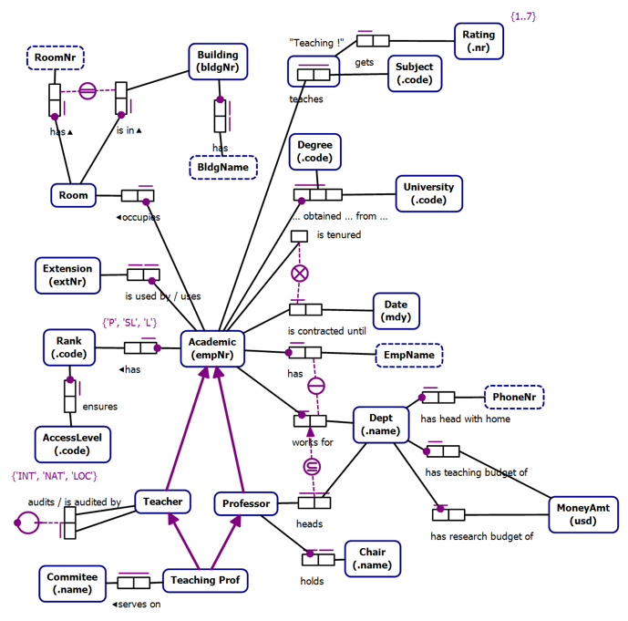
Business Rules as Instructions

Slide 9
Conceptual Models
Technology Agnostic
Transformable into Logical Models
Clarity
Expressive
Formal
Conceptual Models are not a requirement

Slide 10
Object Role Models
A type of conceptual model
Supported by a Visual Studio Extension (NORMA)
Object Role Models are textual and visual
Text can be visualized
Diagrams can be verbalized
Textual representation is in a formal natural language that can be validated by subject matter experts

Slide 11
Workflows
Use cases are specific scenarios that guide data capture and processing in the application
Promote a Lecturer to Senior Lecturer
Promote a Senior Lecturer to Associate Professor
Promote an Associate Professor to Professor
Assign a Class to an Academic
Add a new Academic to the faculty capturing all required information and allowing the capture of optional information

Slide 12
Use Cases
# Use Case: Assign Administrative Role to Academic
- Primary Actor: Provost
- Supporting Actors: Dean, Department Head, HR Administrator, Current Role Holder
- Stakeholders and Interests: Academic (career development), Department (leadership needs), Institution (governance structure), Faculty (representation)
- Goal: Assign an eligible Academic to an administrative role (e.g., Head of Department) with proper validation and transition process
- Scope: Zeus Academia Academic Management System
- Level: User-goal
…

Slide 13
Architecture and Tech stack
SA Recommentations
AI-first

Slide 14
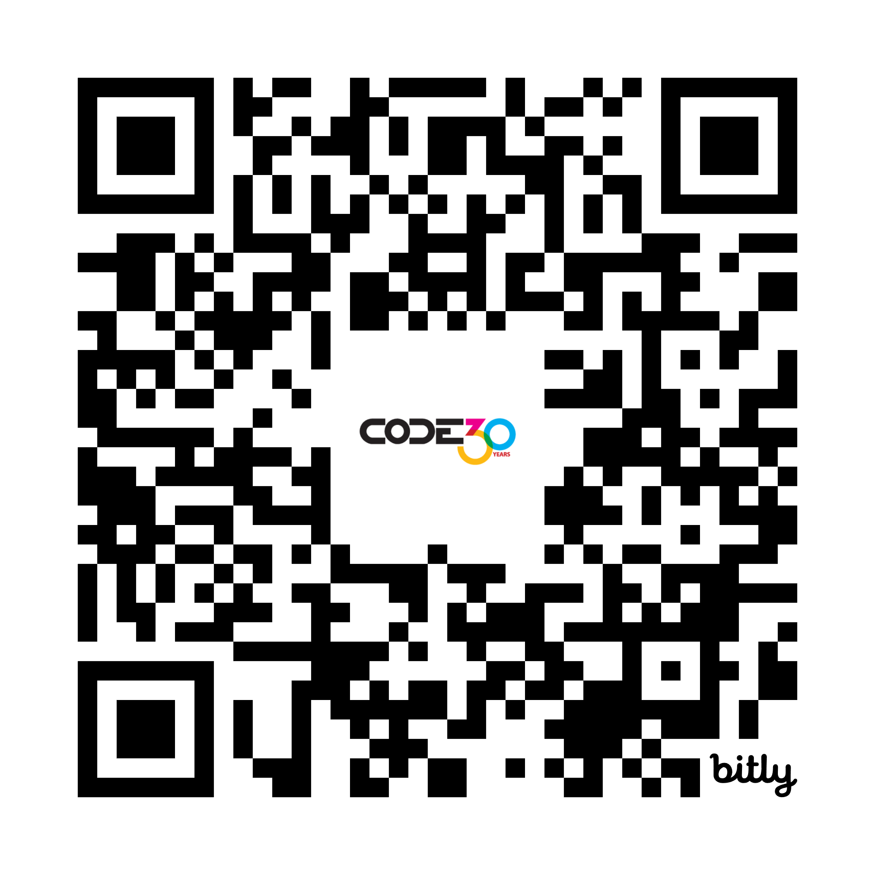

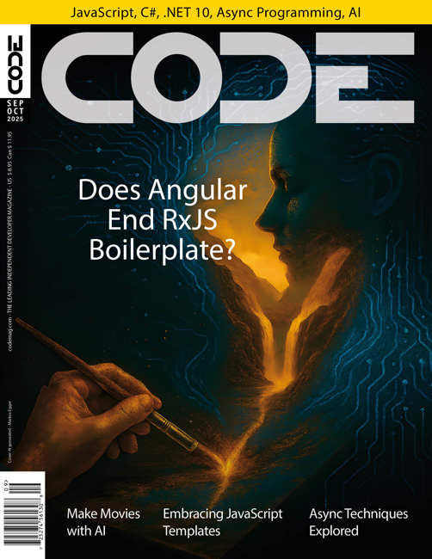
Free Subscription
The leading software development magazine, written by expert developers for developers.
All registered attendees will receive a free digital subscription to CODE Magazine!
Share this link to our free subscription: https://bit.ly/Subscribe112025

Slide 15
Wrap-Up and Open Q&A
Review the day’s learning outcomes.
Address questions or concerns.
Discuss next steps and future learning opportunities.
Notes:
Summarize key takeaways, next steps, and open the floor for questions and feedback.

